Slide 1
Create a data processing module that allow to store and access processed data with information ready
Extract the output of the hidden layer for a given dataset/data batch, and visualize them with T-sne

Slide 2
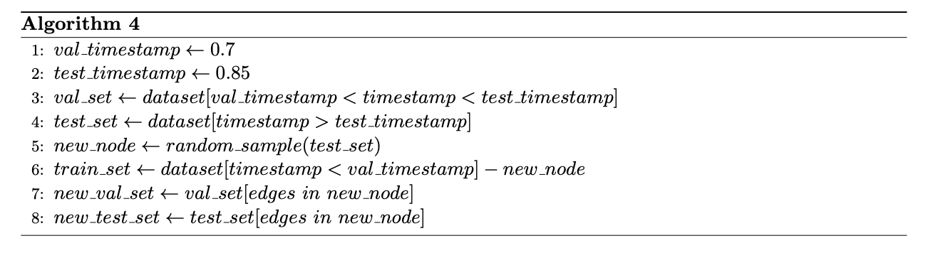
Create a Class GraphDataset() which contains the whole procedure of data processing.
Store the train_data, val_data, test_data, new_node_val_data, new_node_test_data in Class GraphDataset()
When importing the dataset, use the following command in Python:
from utils.data import GraphDataset

Slide 3
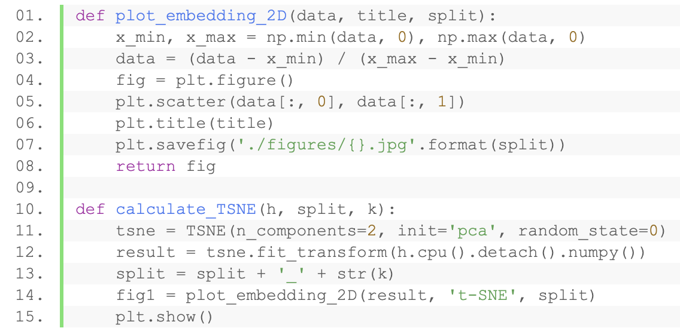
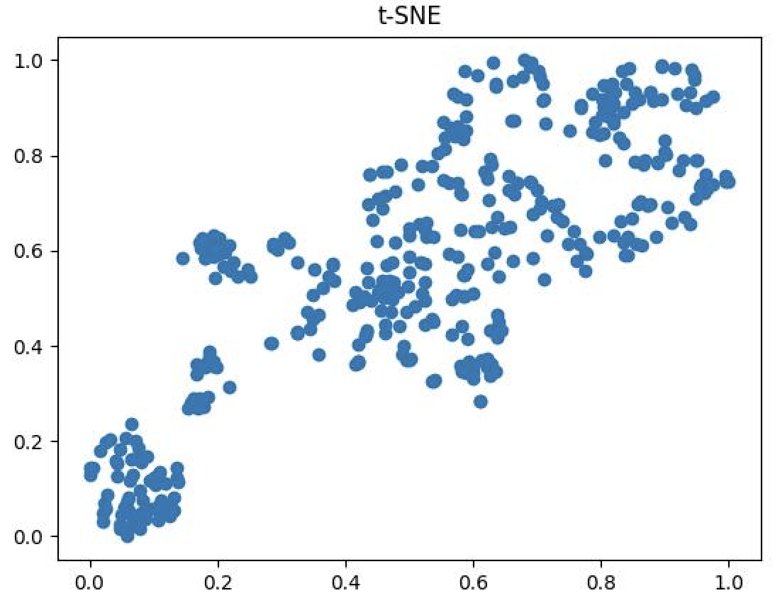
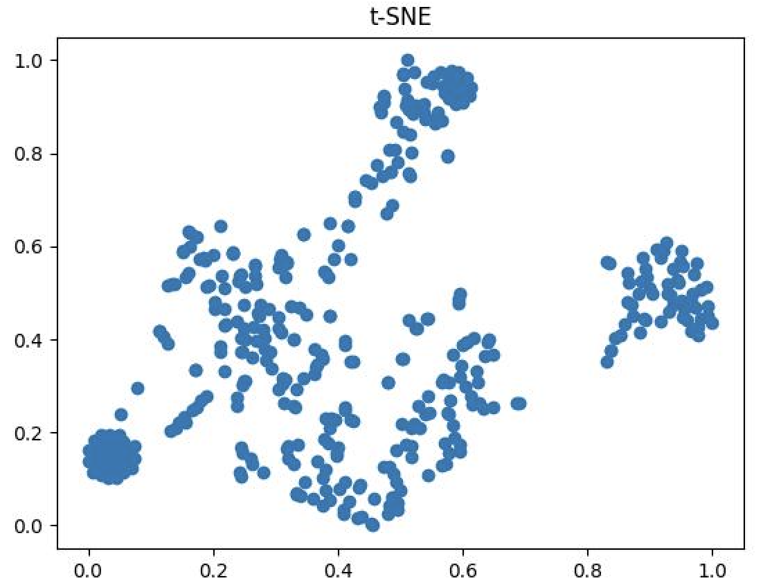
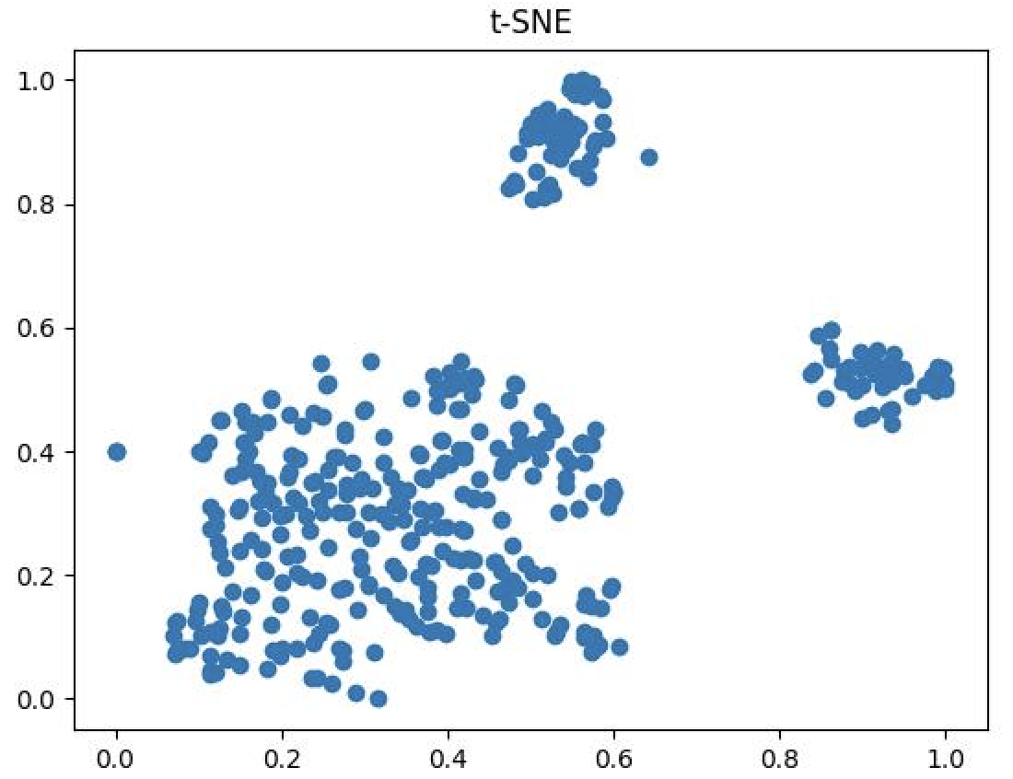
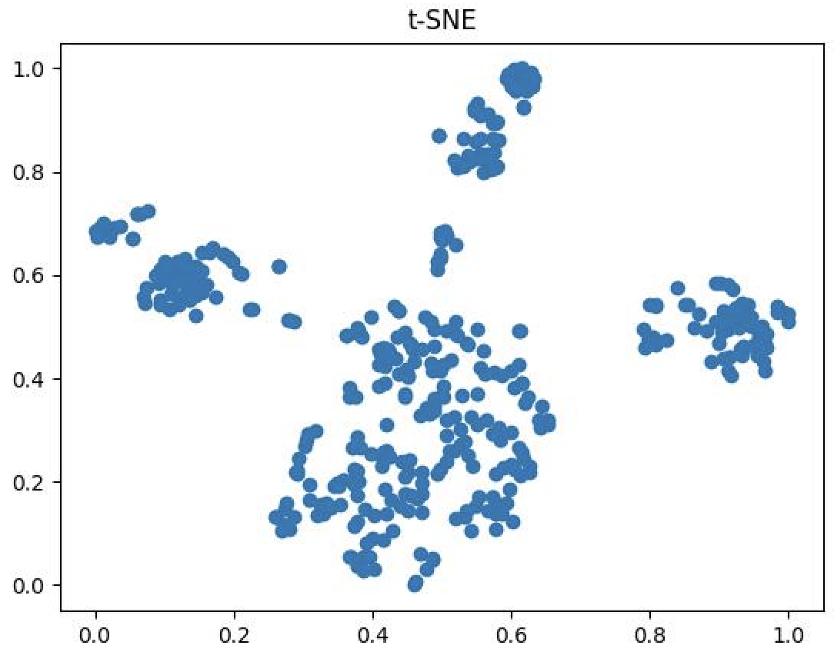
How the representations are returned currently:
Store the output of hidden layer h in the Class and return it as self.affinity_score.h
Code for T-sne:

